Slide 1



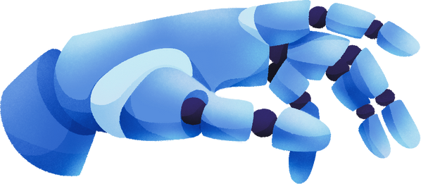
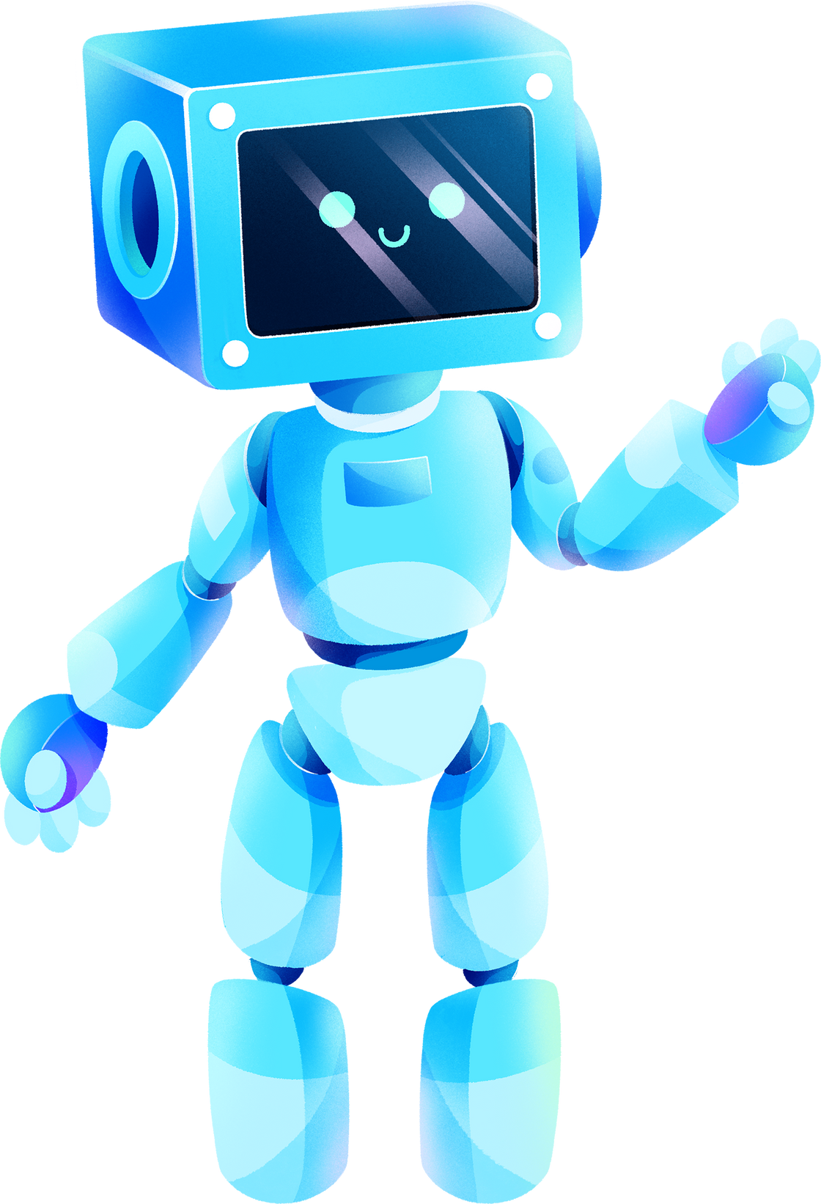
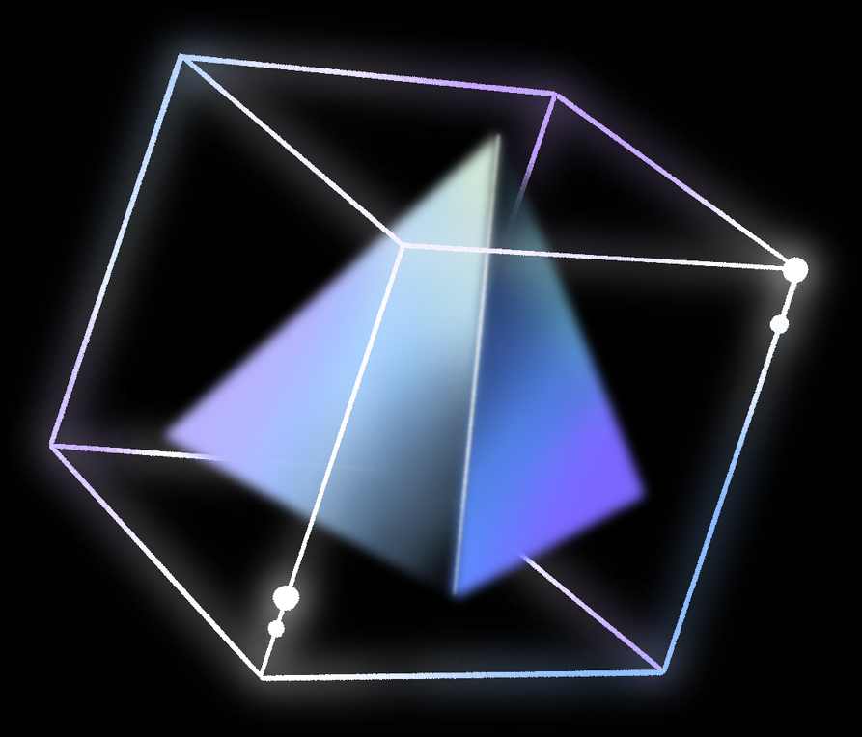
MACHINE LEARNING
KAGGLE CHALLENGE
By Neural Mavericks Team

Slide 2
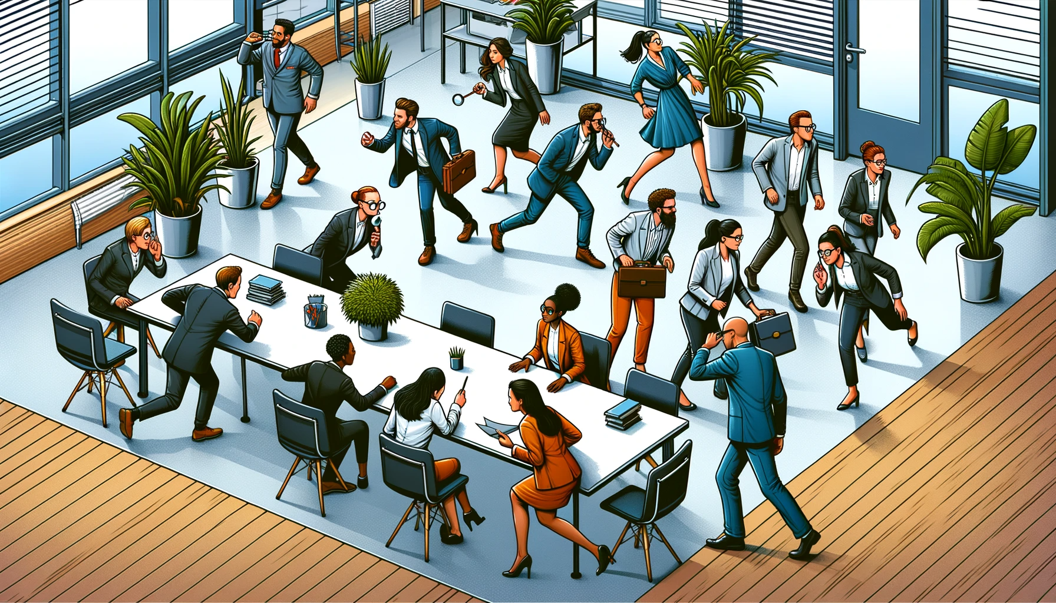

Slide 3
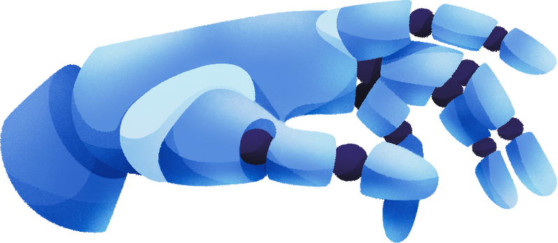
TABLE OF CONTENTS
Description of the task
Data analysis
Our Solution
Economic effect of implementation
01
02
03
04

Slide 4
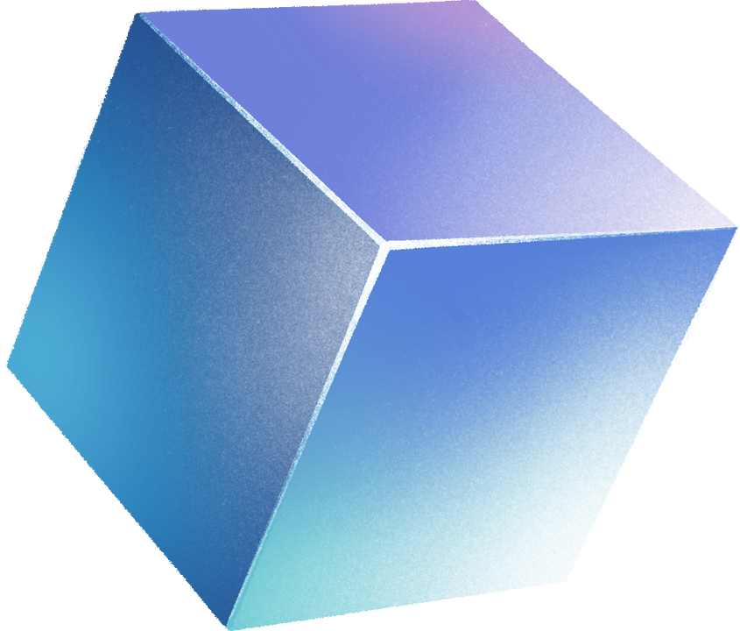
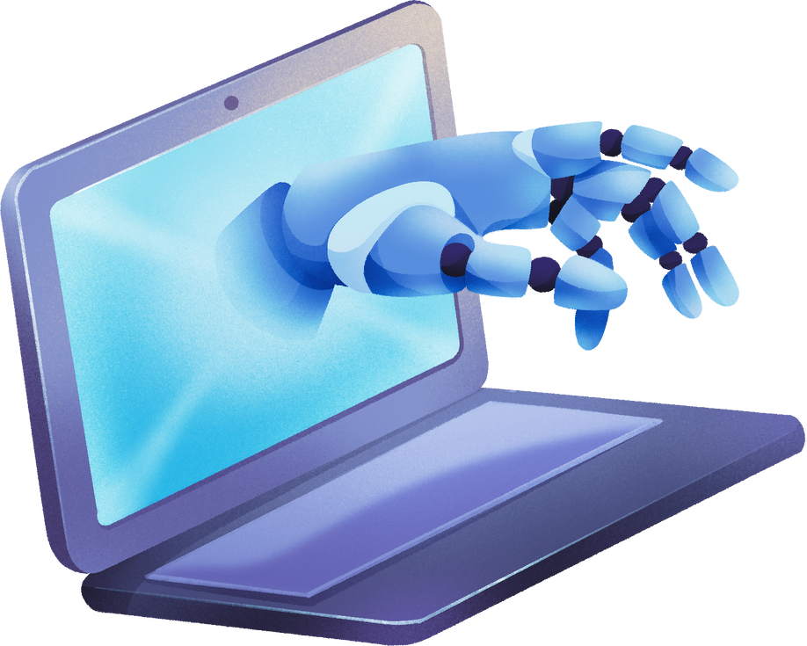
DESCRIPTION OF THE TASK
What problem are we solving?
Classic customer churn prediction challenge. Customer churn, also known as customer attrition, occurs when customers cease doing business with a company.
What should we pay attention first?
it's crucial to first carefully examine and understand the features and target variable in the dataset.
What nuances are there in the problem?
Some nuances in the problem include dealing with imbalanced classes, where the number of churn instances might be significantly lower than non-churn instances

Slide 5
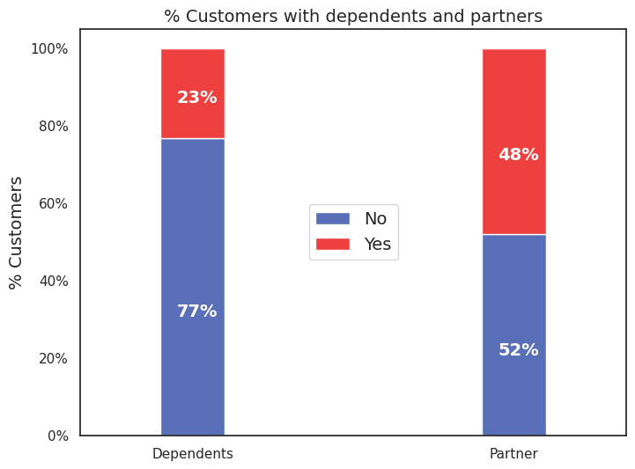
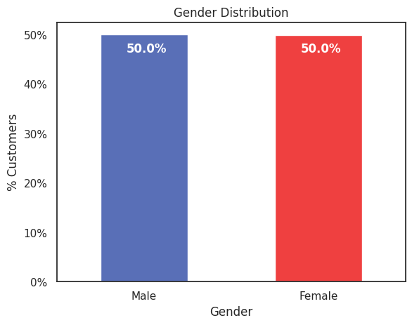
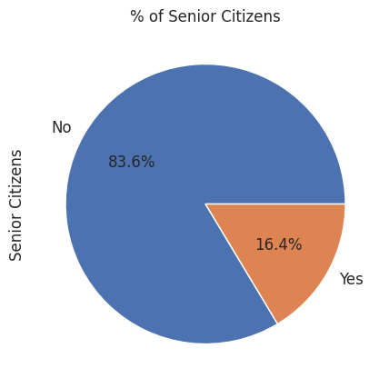
DATA ANALYSIS - DEMOGRAPHICS

Slide 6
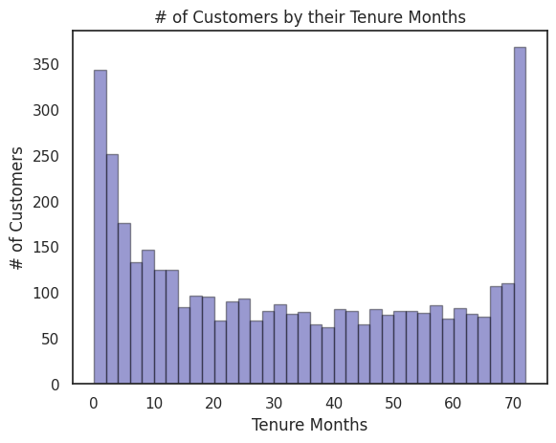
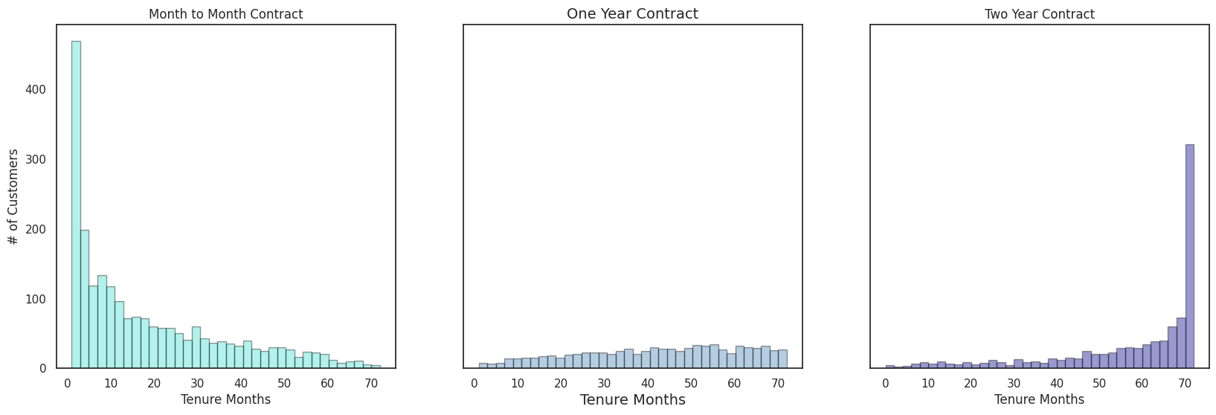
DATA ANALYSIS - ACCOUNT INFORMATION

Slide 7
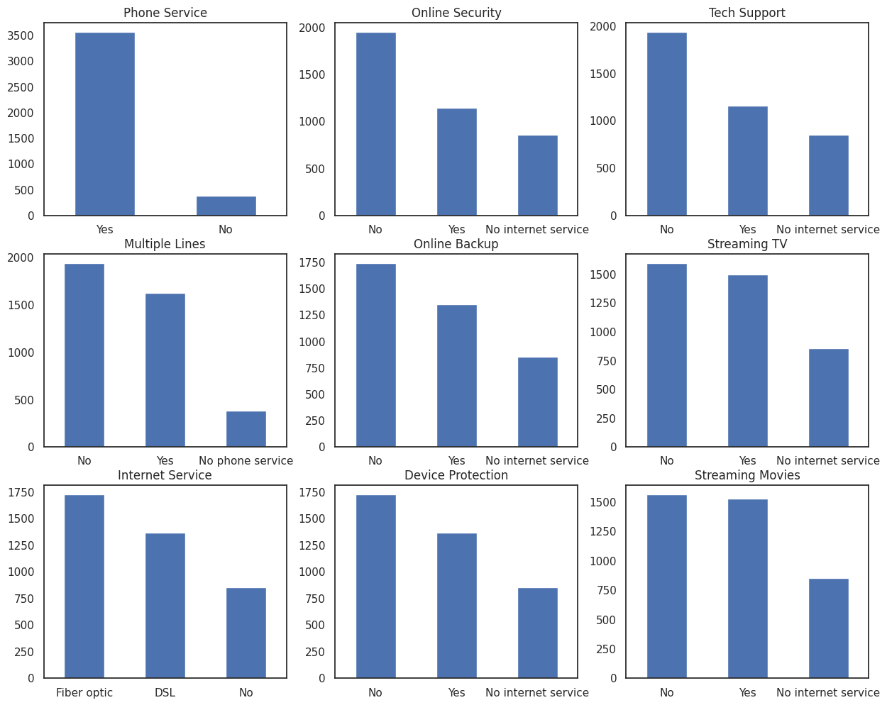
DATA ANALYSIS - SERVICES

Slide 8
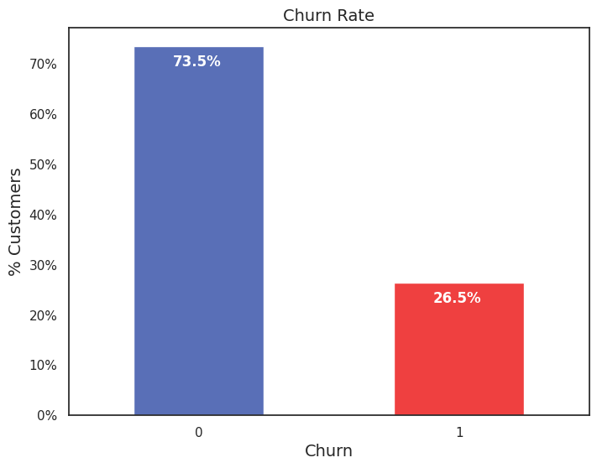
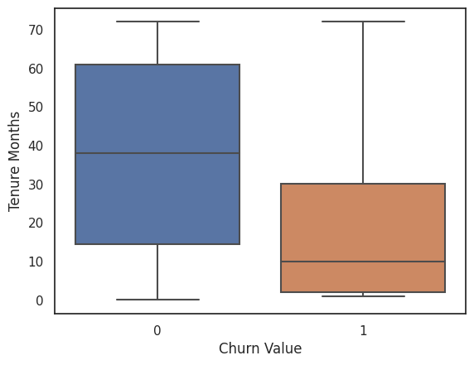
DATA ANALYSIS - CHURN

Slide 9
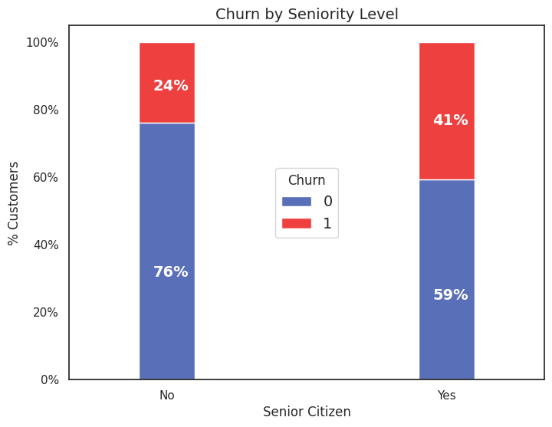
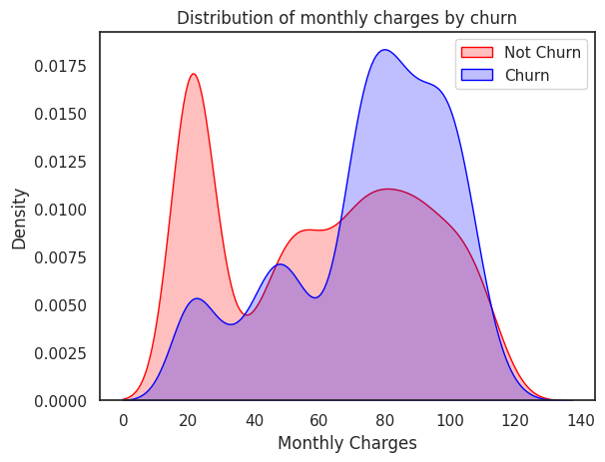
DATA ANALYSIS - CHURN

Slide 10
OUR SOLUTION
Dropped features with no effect
Encoded categorical features
Feature Scaling (MinMax)
Oversampling (SMOTE)

Slide 11
OUR SOLUTION - RESULT
/ | LG | RF | SVC | XGB | LGBM | Stack
Accuracy | 76.64 | 77.24 | 79.31 | 85.43 | 85.43 | 85.60
Cross Validation | 86.83 | 87.98 | 90.36 | 93.82 | 93.97 | 93.96
ROC-AUC Score | 76.74 | 77.31 | 79.41 | 85.48 | 85.49 | 85.61

Slide 12


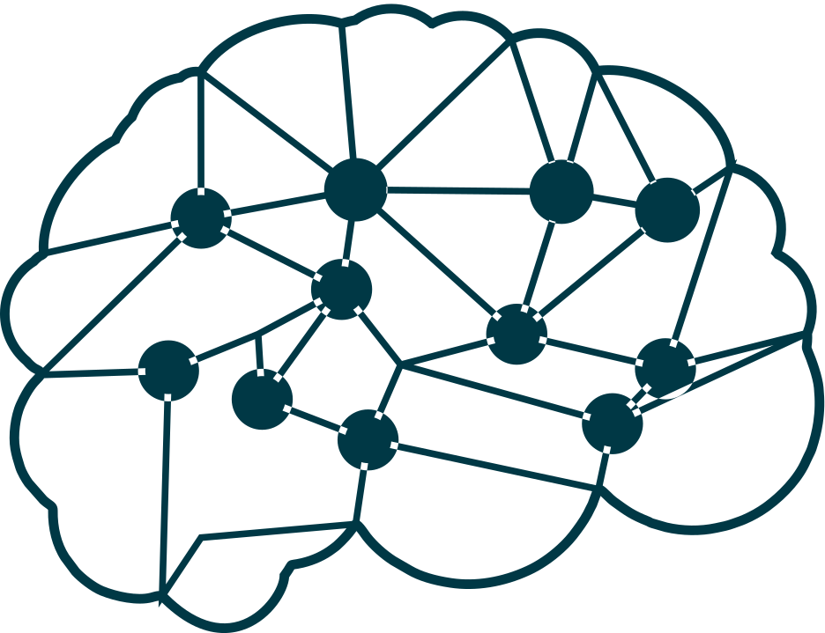


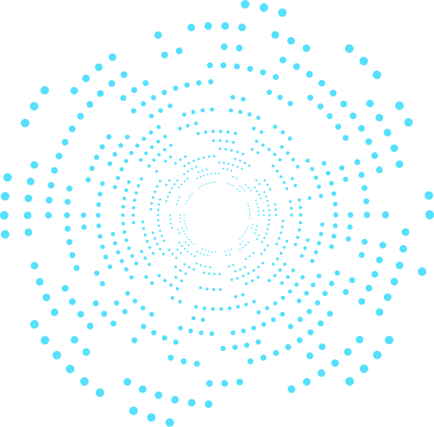

4
ECONOMIC EFFECT OF IMPLEMENTATION
HOW THIS MODEL WILL BE USED?
WHAT WILL BE THE ECONOMIC EFFECT OF IMPLEMENTING SUCH A MODEL?
HOW WILL YOU DEAL WITH USERS THAT THE MODEL HAS FLAGGED AS CHURN-PRONE?
The model can be integrated into the customer management system or CRM platform to automatically flag customers who are likely to churn based on the model's predictions.
By identifying customers who are likely to churn in advance, the company can allocate resources more effectively to implement targeted retention strategies.
the company can implement targeted interventions. These interventions might include reaching out to these customers with tailored offers or providing them with personalized customer support to address any issues or concerns.

Slide 13
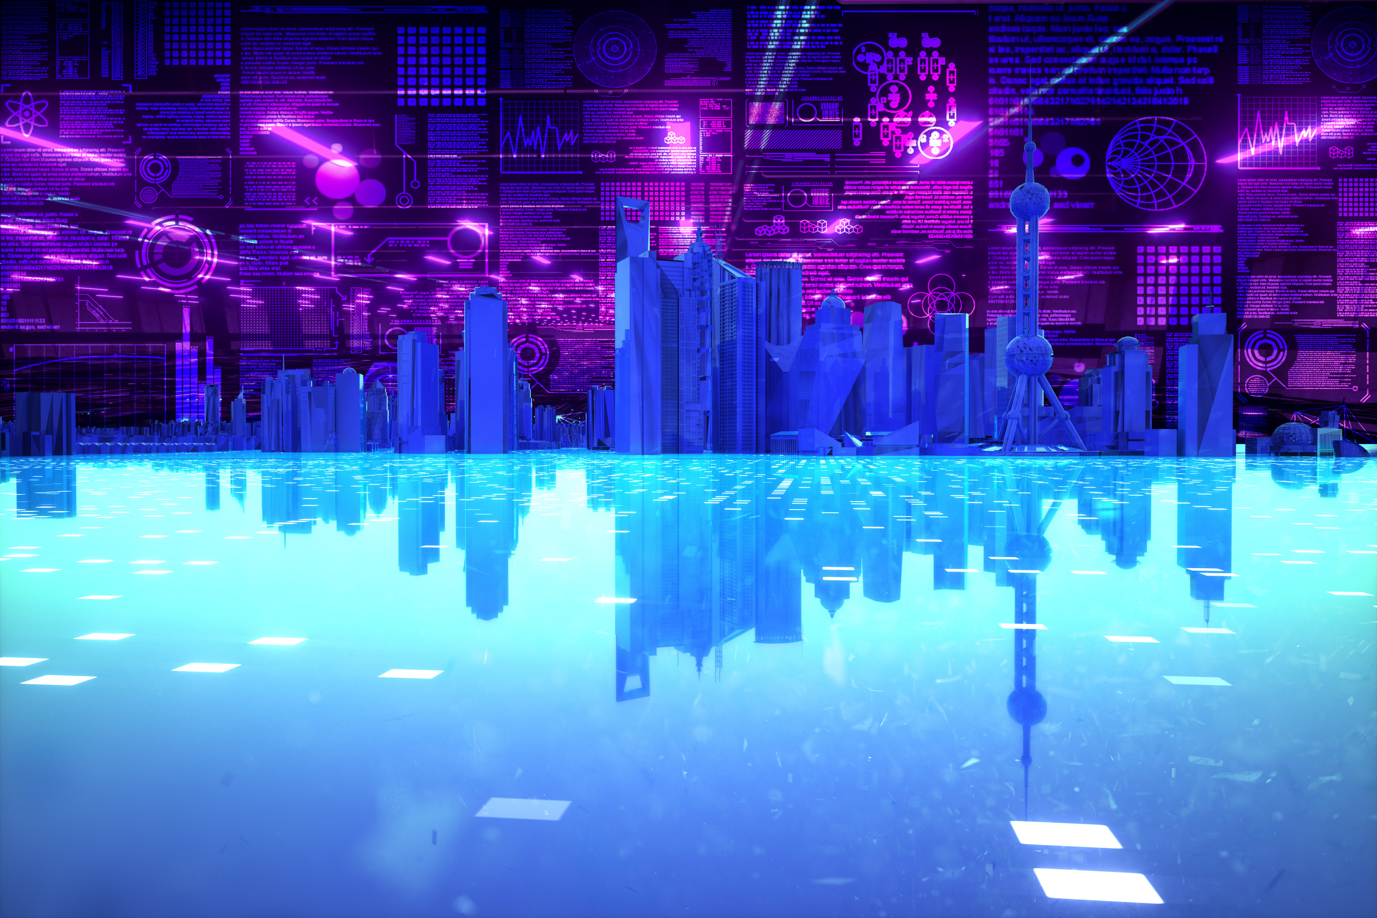
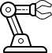
Thank You!
Neural Mavericks

